Slide 1
Filtering

Slide 2
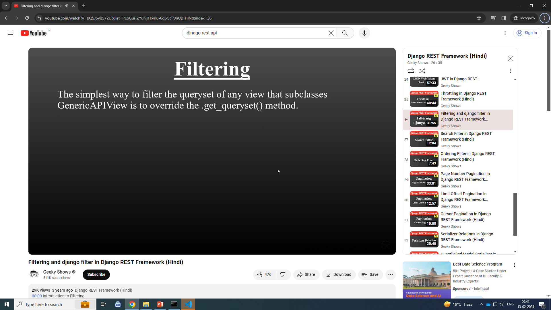

Slide 3
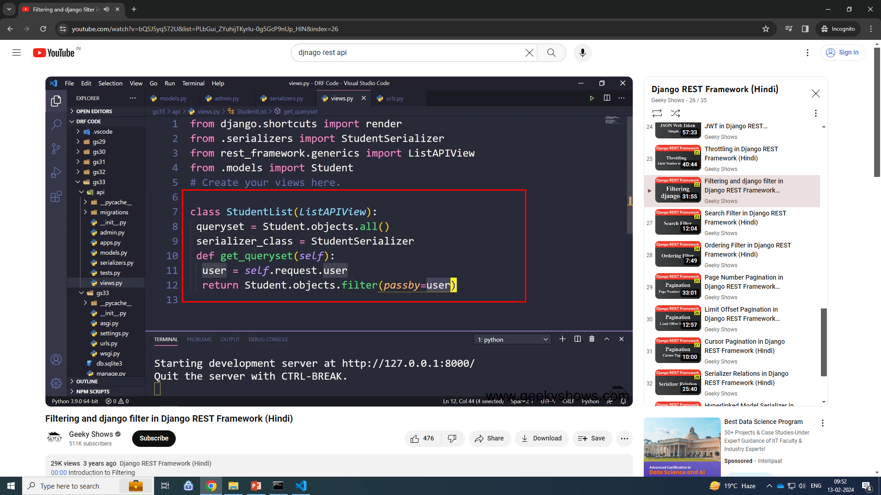

Slide 4
get_queryset()- method override to filter data in api
class MyThrotal(viewsets.ModelViewSet):
queryset = ParentLocations.objects.all()
serializer_class = ParentLocationSerializer
authentication_classes = [SessionAuthentication]
permission_classes = [IsAuthenticatedOrReadOnly]
# throttle_classes = [UserRateThrottle, AnonRateThrottle]
throttle_classes = [LkRateThrottle, AnonRateThrottle]
def get_queryset(self):
return ParentLocations.objects.filter(location_name="Pune")

Slide 5
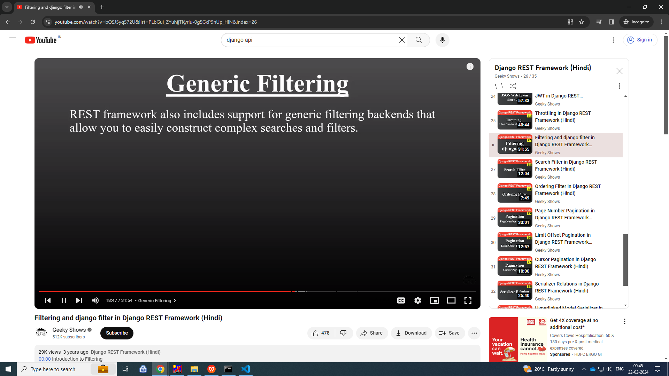
Generic Filter

Slide 6

DjangoFilterBackend

Slide 7
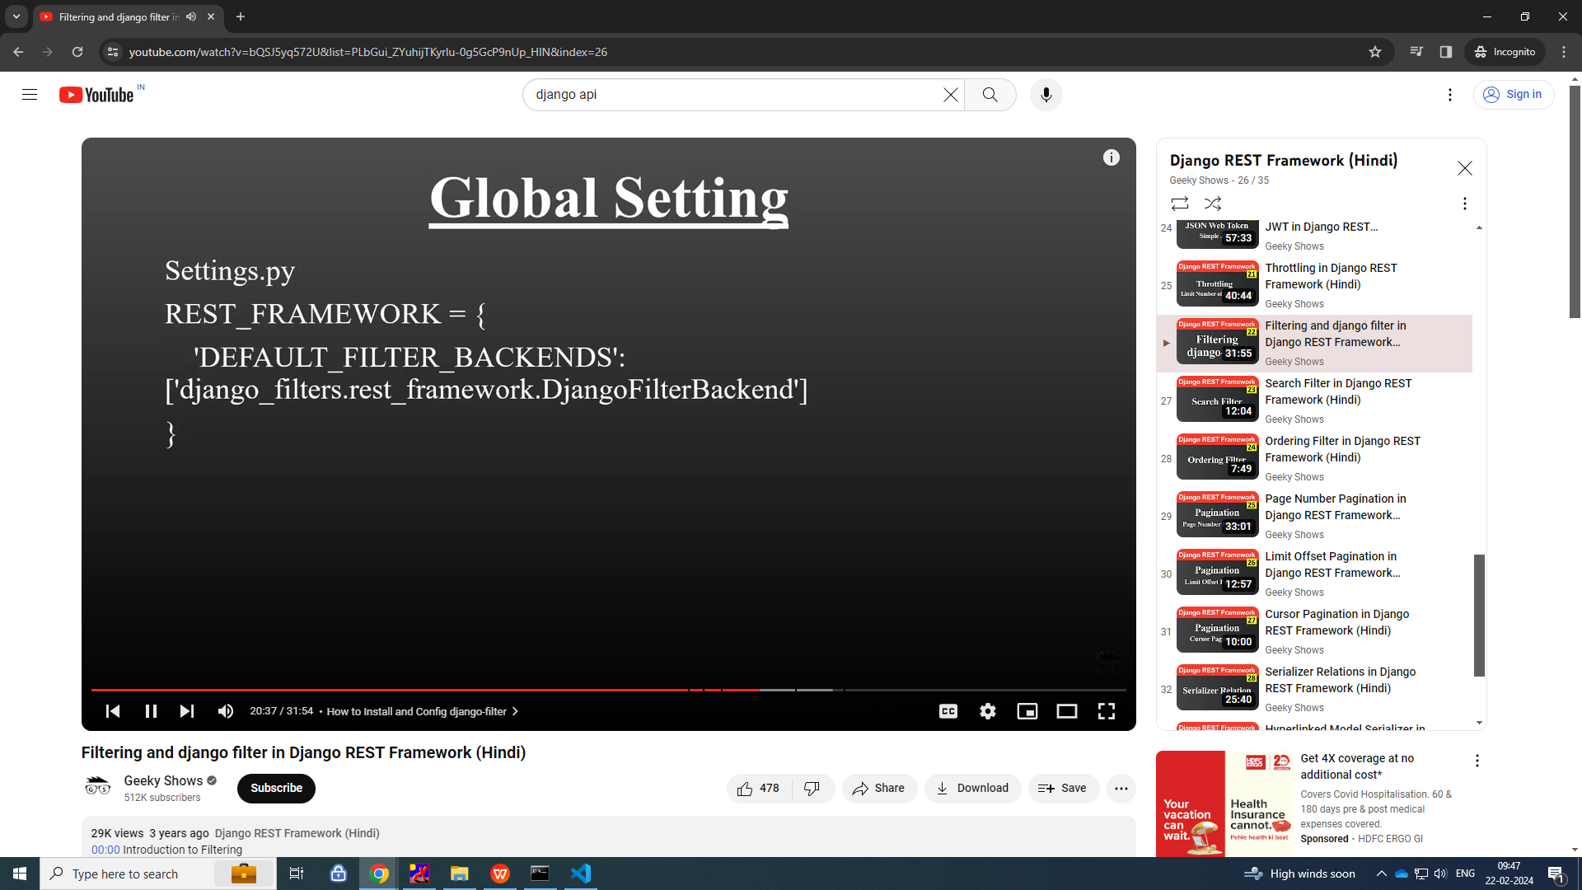

Slide 8
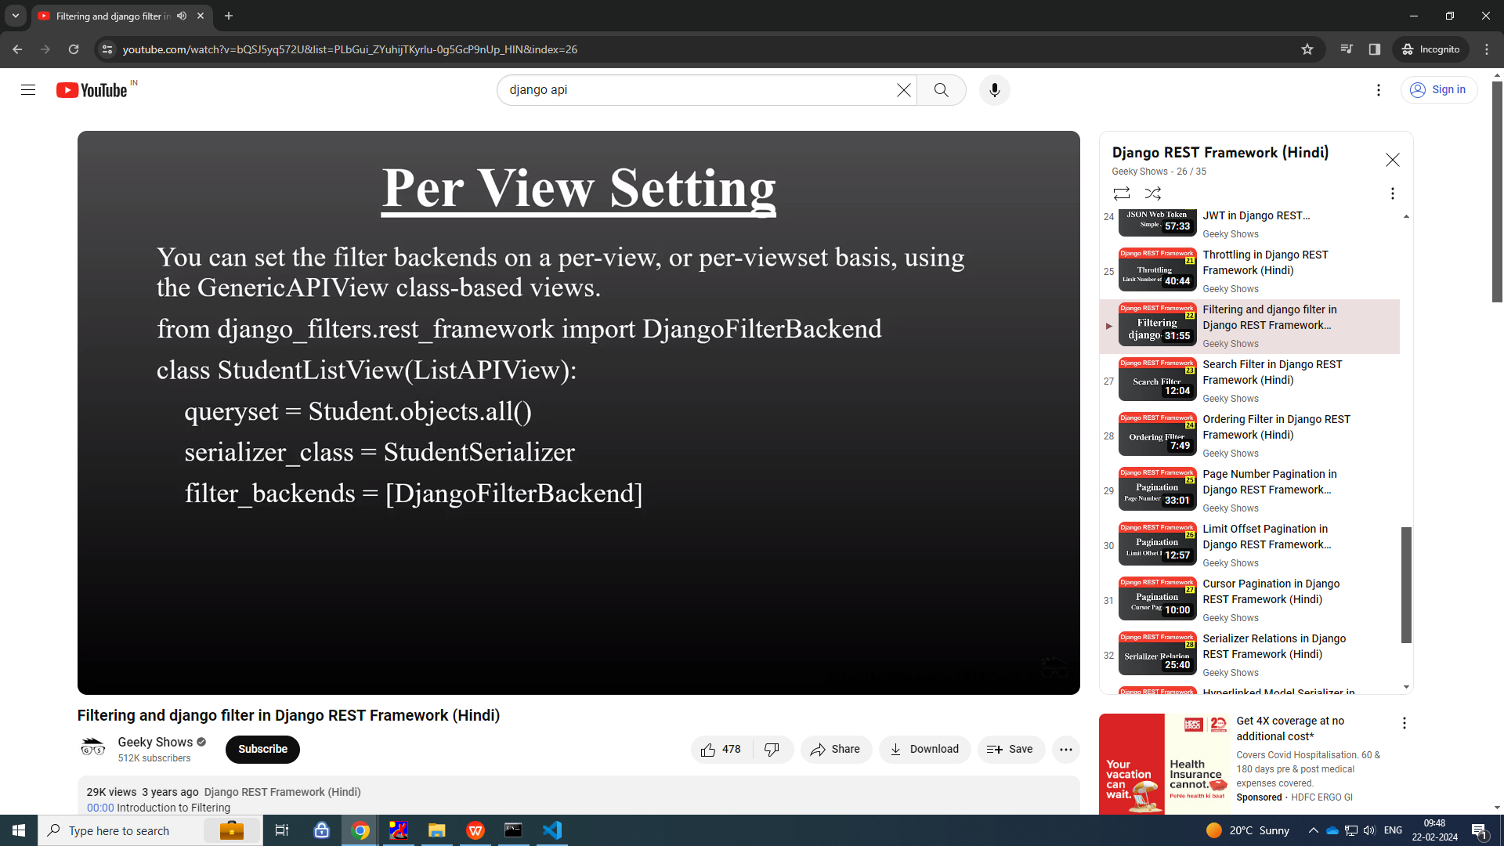

Slide 9
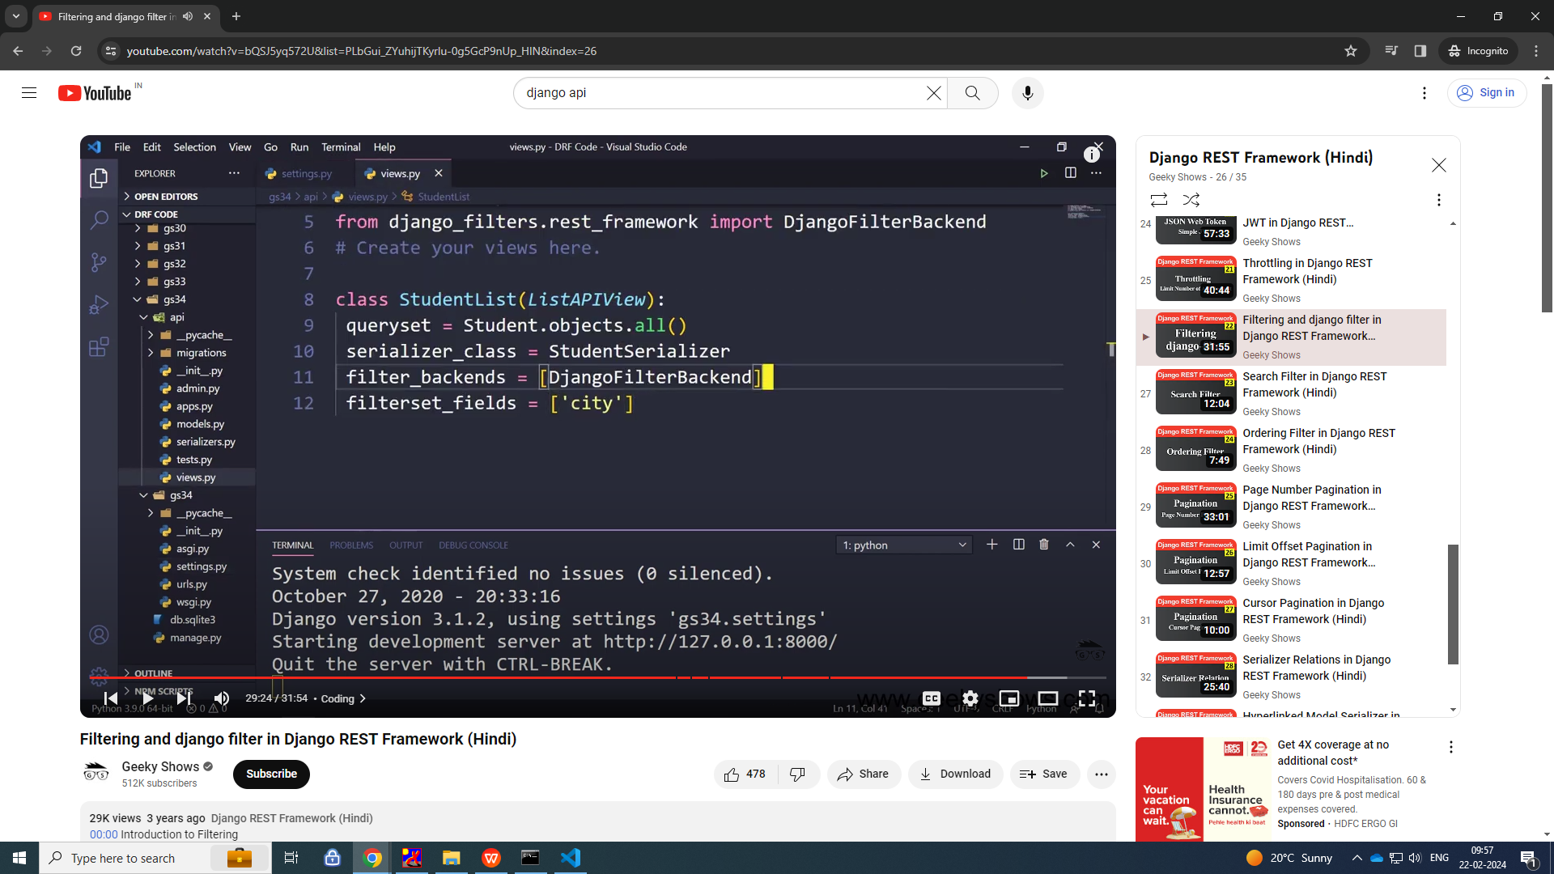

Slide 10
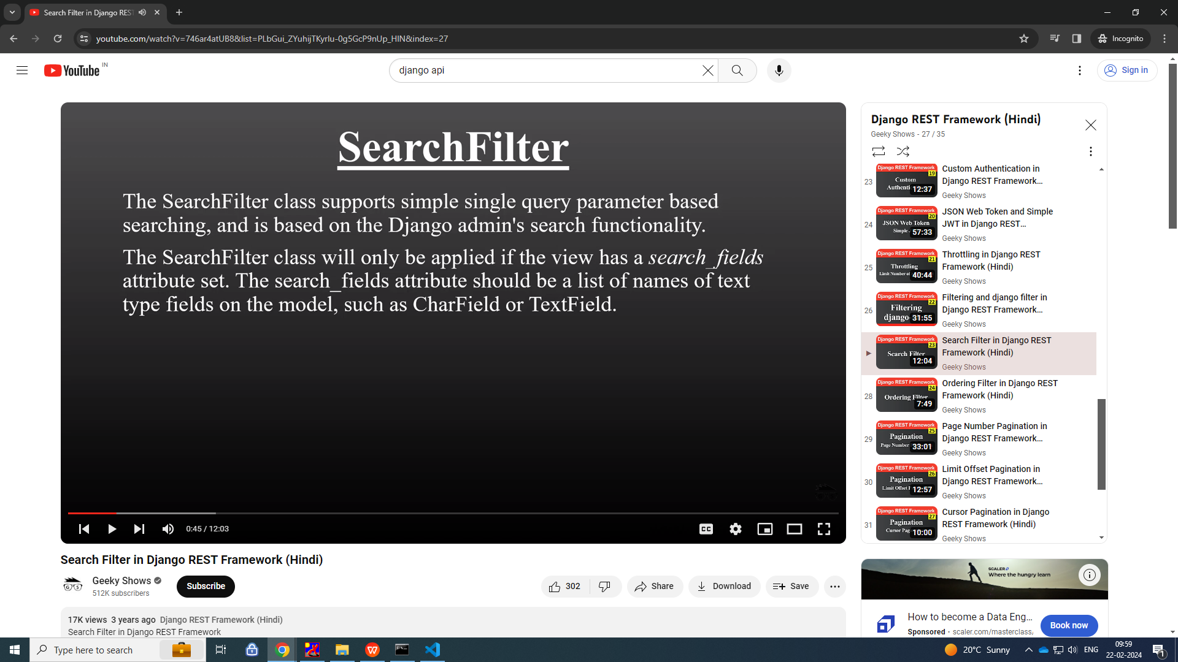
searchfield

Slide 11
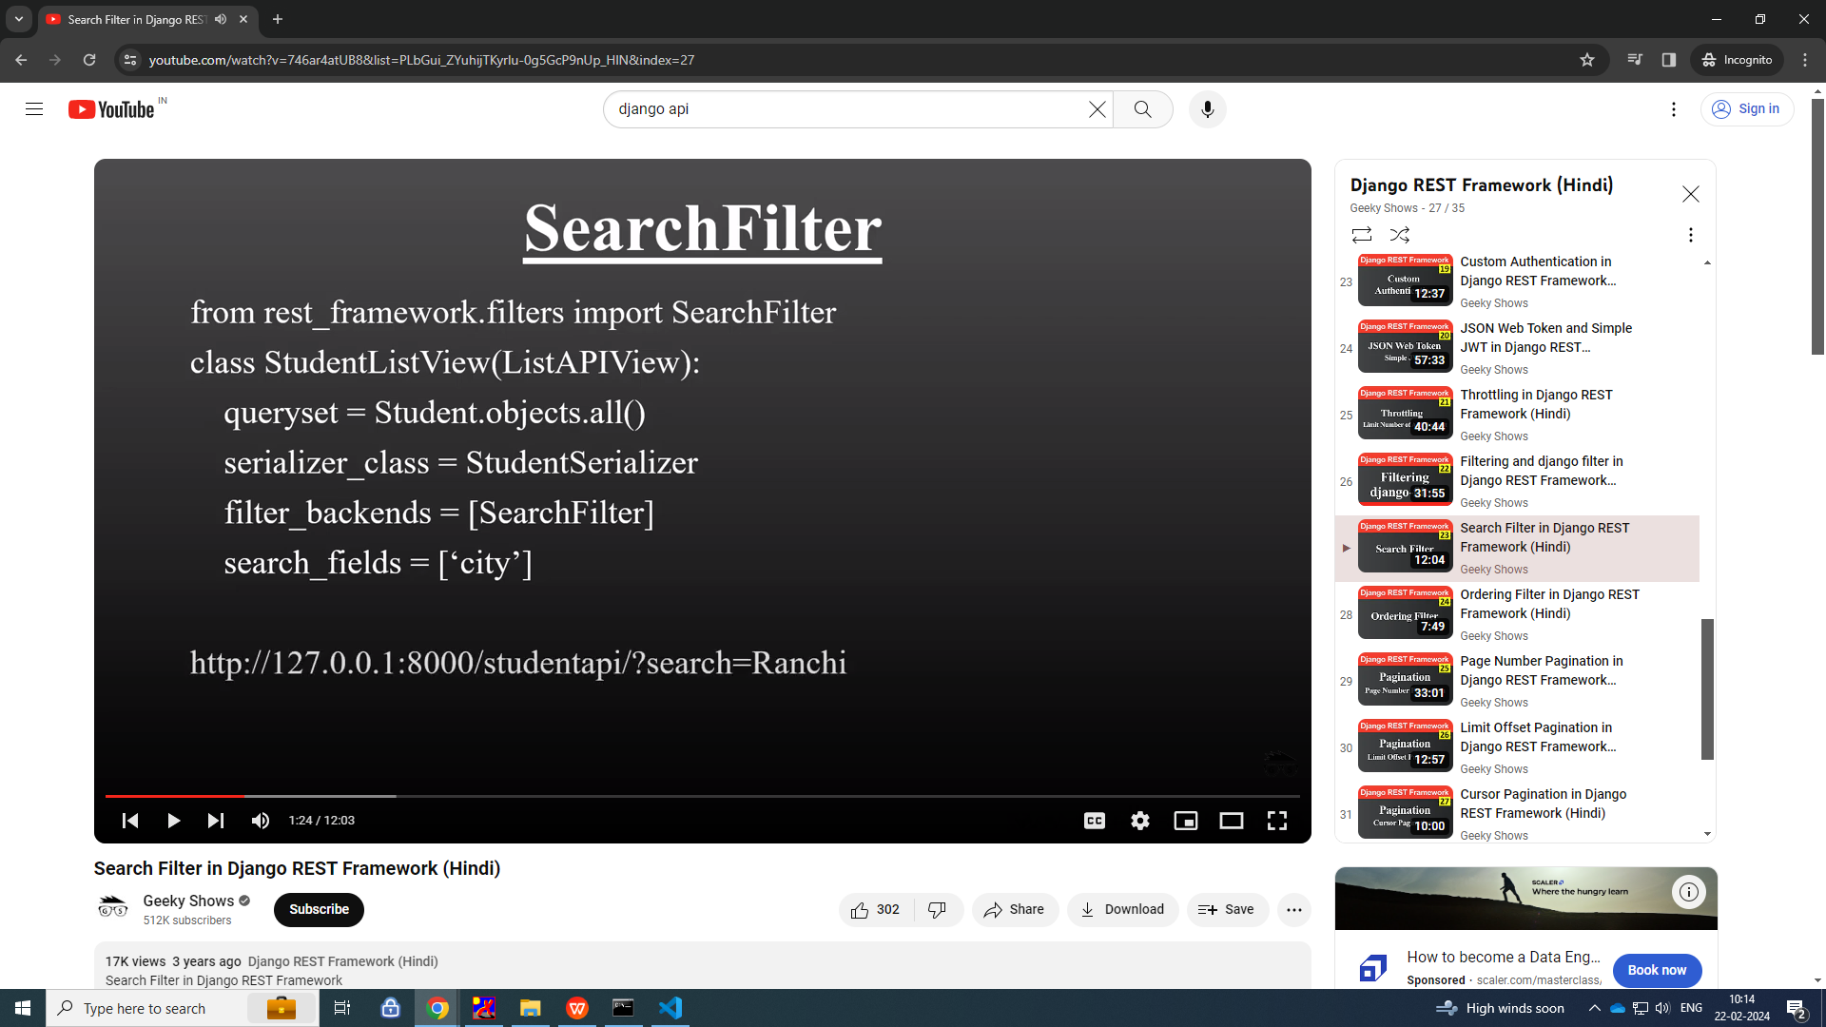
Searchfilter

Slide 12
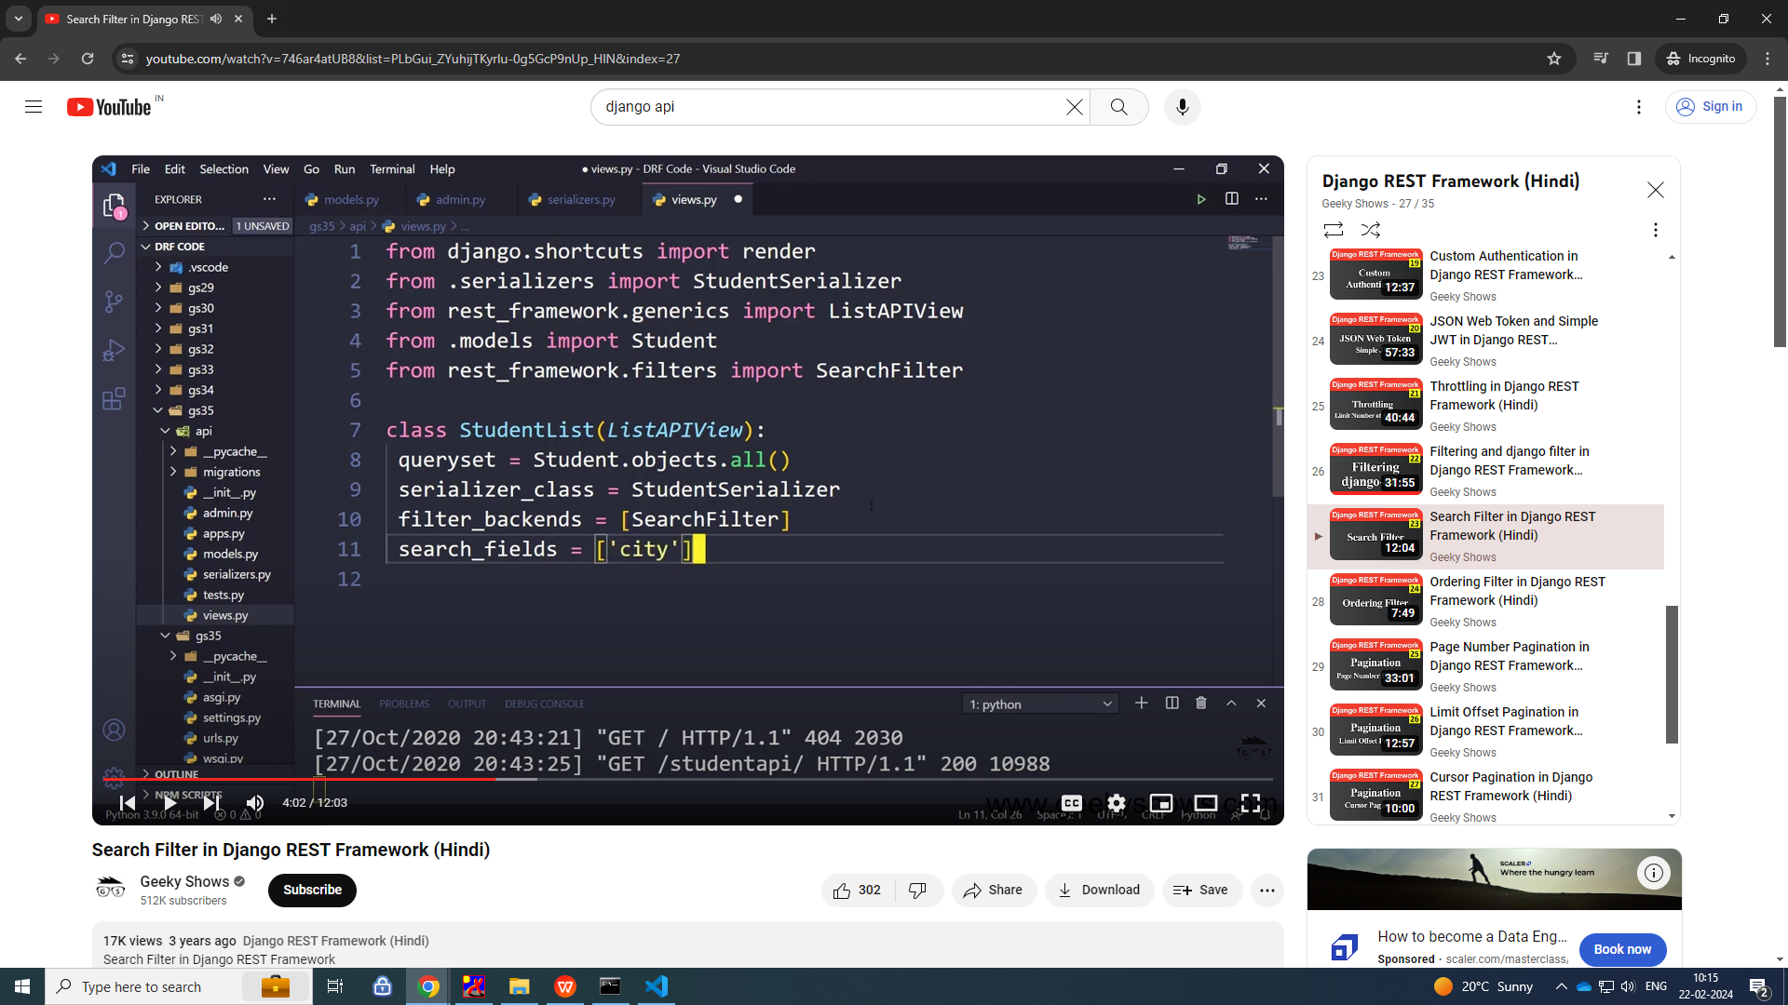

Slide 13
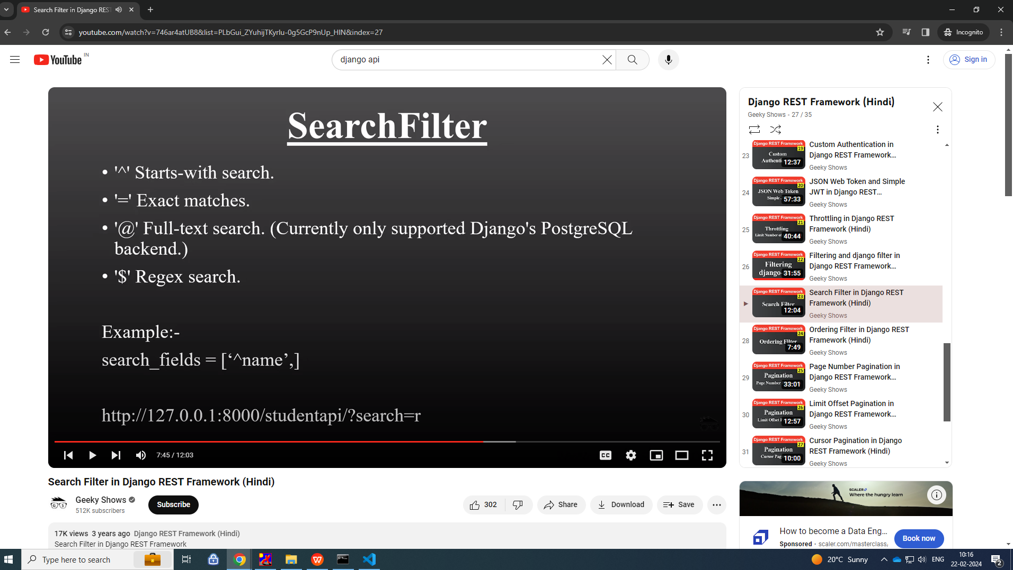

Slide 14
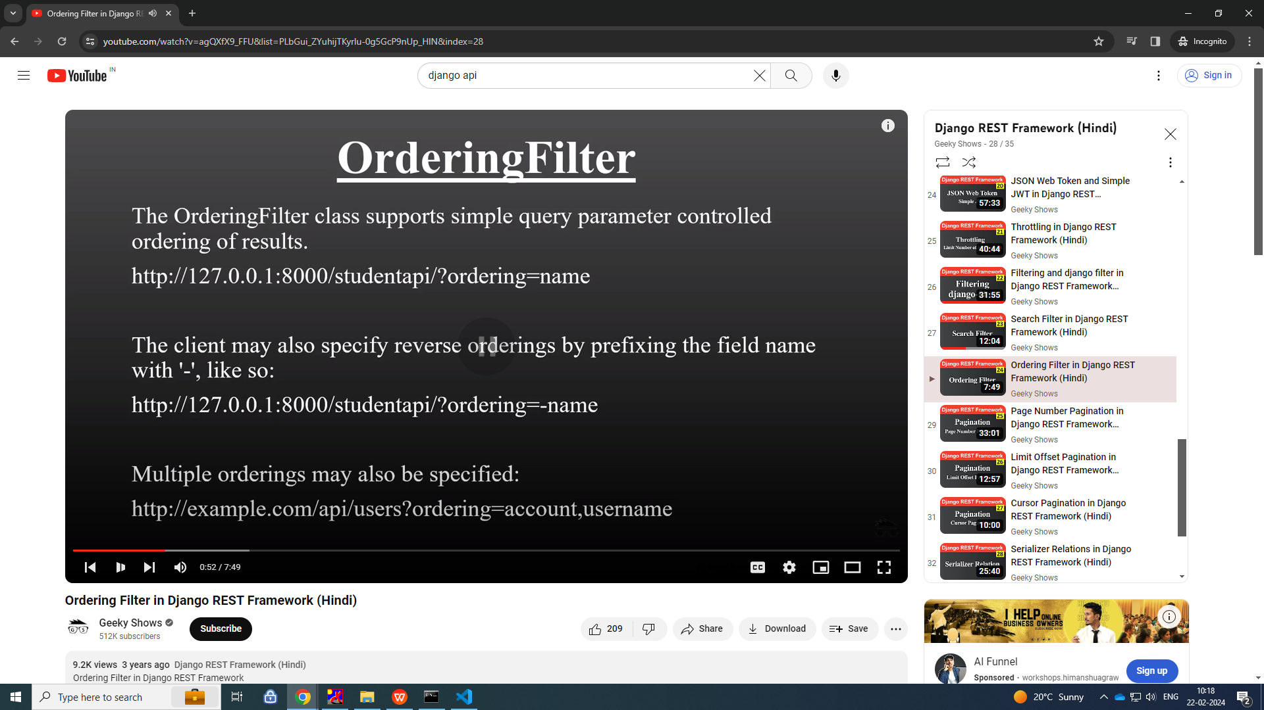
ordering

Slide 15
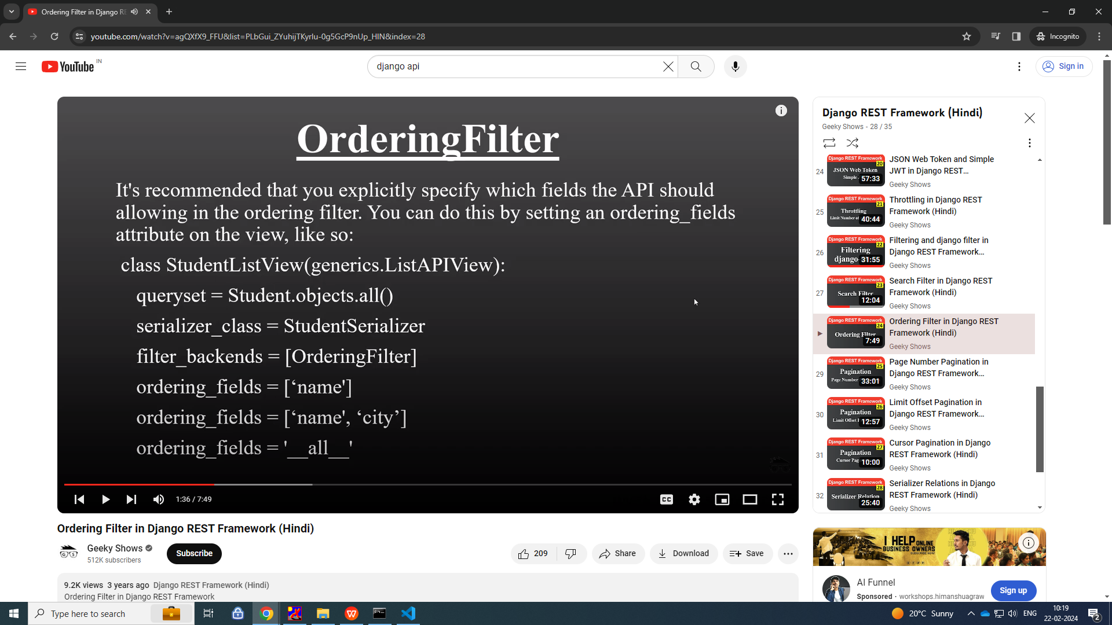

Slide 16
